Slide 1


OBJECT ORIENTED PROGRAMMING 2
PROJECT
SECTION : O
Group No : 6
PROJECT TITLE : Career Opportunity
COURSE INSTRUCTOR: MD. NAZMUL HOSSAIN
PROGRAM: BSc. CSE

Slide 2
Group Member Details
Roll NO. | Group Member’s Name | Group Member’s ID
18. | BASAK, RITU | 19-40179-1
30. | ANI, ANINDITA BISWAS | 19-40782-2
23. | HAQUE, FAHMIDA | 19-40408-1
24. | HOSSAIN, SORMILA | 19-40412-1

Slide 3

Career Opportunity
Short Description: Career is a path or progress through life. It is a profession or occupation chosen as one's life's work. An opportunity is a situation in which it is possible for you to do something that you want to do in your career. Career Opportunity is the best key to reach one’s life goal.

Slide 4

PROJECT OBJECTIVE/MOTIVATION
In this project we are mainly trying to build an online platform for Companies and Job Seekers of Bangladesh. From our built in project, both companies and job seekers will get the best facilities as their needs.
In Bangladesh at present, many job seekers are unemployed because of finding the best and suitable job for them. They often find the job in outside of our country. They think that doing job outside of country is more better and perfect than doing job in Bangladesh. But for the lack of knowledge of job marketing site ,they actually do not realize that Bangladesh also have the best job platform for them. So, from our job market site, they can find easily the best job for them. On the other hand, Companies will also be benefited. They can hire the best and experienced employee for their industry. None will be unemployed. Every job seeker will get the perfect job for him/her as per as his /her education and skills.
Hence, it is an essential platform to find a perfect job that appeals to the person with the right education and experience, according to that company.

Slide 5

PROJECT DETAILS
USERS:
Company
Job Seeker
Top Rated Company
Normal Company
Special Skilled Job
Normal Job
Normal Job
Experienced Job Seeker
Normal Job Seeker
Student

Slide 6
USER
Company
Login
Manage/Update Account
Post Job
Send Massage
Receive Massage
Change Password
Logout
Manage/Update own personal details.

Slide 7
USER
Job Seeker
Login
Search Job
Job List
Select Job
Apply Job
Manage/Update Account
Send Massage
Receive Massage
Change Password
Logout
Manage/Update own personal details.

Slide 8
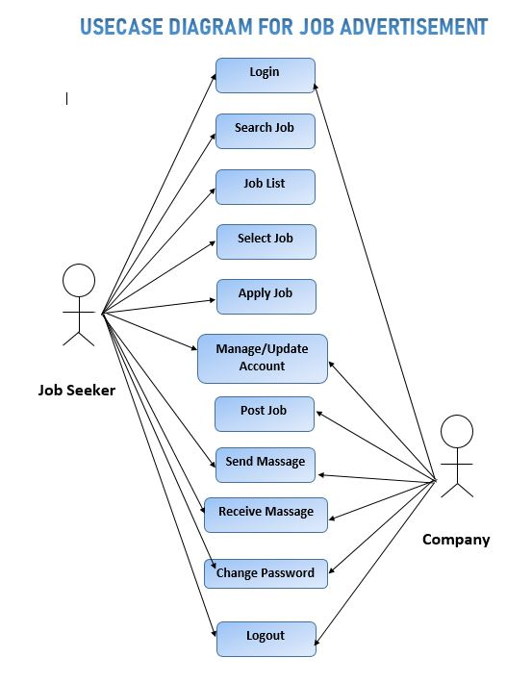

Slide 9
FUNCTIONALITIES
Company
Can have more than one company account with valid name & ID.
Can Login & Logout anytime.
Can manage or update personal information.
Can post Job with details.
Can communicate with Job Seeker. Can send & receive massages.
Can change own password anytime after login.

Slide 10
FUNCTIONALITIES
Job Seeker
Can have more than one account with valid name & ID.
Can Login & Logout anytime.
Can search Job from the Job List.
Can select suitable job and apply for the job.
Can communicate with Company. Can send & receive massages.
Can change own password anytime after login.

Slide 11
DRAWBACKS OF THIS PROJECT
This project is not perfect, as we completed our project within a short period.
In this project there will have some problems or bugs.
There is no function of Advanced Security and Graphics.
For the Covid-19 pandemic, we had some issues that’s why we couldn't completed our project as we wanted.

Slide 12
FUTURE PLAN OF THIS PROJECT
UPDATED VERSION:
We will try to reduce some problems that existence in this project which we found from the feedback by developing an advance security system.
We divided the future enhancement of this system into three areas of improvements, as follows:
i) Graphic improvements
ii) Advanced security improvements
iii) Technical improvements
iv) Contents improvements
We will add high level management and flexibility so that various types of users can easily use it.
Lastly, we will build some advance features applications by improving developer productivity and reducing project life cycle times.

Slide 13
CONTRIBUTIONS
BASAK, RITU – did 30% of this project.
ANI, ANINDITA BISWAS – did 25% of this project.
HAQUE, FAHMIDA – did 25% of this project.
HOSSAIN, SORMILA – did 20% of this project.

Slide 14


